Slide 1



From Zero to Streaming Hero
David Kjerrumgaard | Developer Advocate
https://github.com/david-streamlio/zero-to-hero

Slide 2







Apache Pulsar Committer
Former Principal Software Engineer on Splunk’s messaging team responsible for Splunk’s internal Pulsar-as-a-Service platform.
Former Director of Solution Architecture at Streamlio.
Global practice director of Professional Services at Hortonworks.
David Kjerrumgaard
Developer Advocate
Notes:
Former Principal Software Engineer on Splunk’s messaging team that is responsible for Splunk’s internal Pulsar-as-a-Service platform.
Former Director of Solution Architecture at Streamlio where he was responsible for the development of best practices and solutions based on Apache Pulsar.

Slide 3

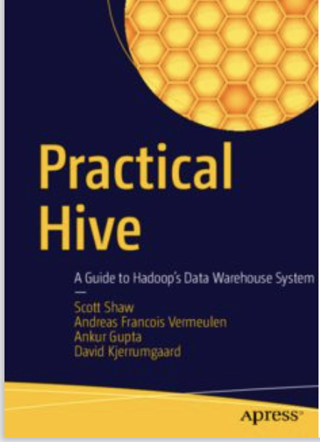

Author of Pulsar In Action.
Co-Author of Practical Hive
David Kjerrumgaard
Author
https://streamnative.io/download/manning-ebook-apache-pulsar-in-action

Slide 4
Outline
What is Data Streaming?
Streaming Data Platform Reference Architecture
eCommerce Use Case
Demonstration
Q&A
Notes:
Title: **Building Scalable and Resilient Event-Driven Apps with Apache Pulsar**
**Introduction**
- Briefly introduce the topic and its relevance in the modern application development landscape.
- Highlight the increasing importance of event-driven architectures for building responsive and efficient applications.
**Understanding Event-Driven Architecture**
- Define event-driven architecture and its core concepts.
- Explain the benefits of decoupling components, improved scalability, and real-time responsiveness.
**Introducing Apache Pulsar**
- Provide an overview of Apache Pulsar as a robust event streaming platform.
- Highlight Pulsar's key features that make it suitable for building scalable and resilient event-driven apps.
**Scalability in Event-Driven Apps**
- Discuss the challenges of scaling applications to handle large numbers of events.
- Explain how Apache Pulsar's architecture supports seamless horizontal scalability for both producers and consumers.
**Resilience and Reliability**
- Address the importance of ensuring high availability and data durability in event-driven architectures.
- Explore how Apache Pulsar achieves resilience through its architecture, durable storage, and replication mechanisms.
**Case Study: Building a Resilient Microservices Ecosystem**
- Present a case study of building a microservices-based architecture using Apache Pulsar.
- Showcase how event-driven communication enhances the resilience and scalability of the ecosystem.
**Best Practices for Building Event-Driven Apps with Apache Pulsar**
- Offer practical tips and best practices for designing and developing event-driven applications using Apache Pulsar.
- Cover topics like topic design, message schemas, and choosing the right subscription strategy.
**Demonstration or Walkthrough**
- Depending on the presentation format, consider including a live demonstration or a step-by-step walkthrough of setting up a simple event-driven app using Apache Pulsar.
**Challenges and Future Trends**
- Discuss potential challenges in adopting and implementing event-driven architectures.
- Highlight future trends and developments in the event streaming and event-driven app landscape.
**Conclusion**
- Recap the main points covered in the presentation.
- Reinforce the benefits of using Apache Pulsar for building scalable, resilient, and efficient event-driven applications.
- Encourage the audience to explore Apache Pulsar further and consider its applicability in their own projects.

Slide 5

What is Streaming?

Slide 6
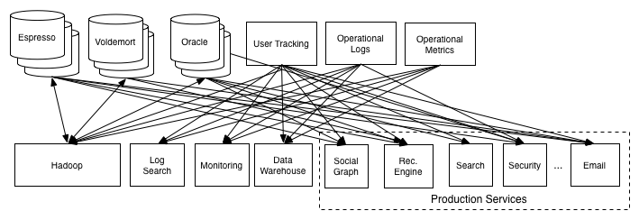
The Origin of Data Streaming
In 2010, LinkedIn needed to ingest large amounts of data from its website and internal infrastructure logs and replicate it to multiple databases with minimal latency.
Notes:
In the late 2000’s, LinkedIn was starting to run into an issue with scaling its data replication framework.
It simply had too much data that needed to be shared with too many systems
As you can see from this image from the original engineering blog post, every system needed data from multiple different sources.
Worse yet, whenever a new data source came online, it had to be fed into N consuming systems.
https://engineering.linkedin.com/distributed-systems/log-what-every-software-engineer-should-know-about-real-time-datas-unifying

Slide 7
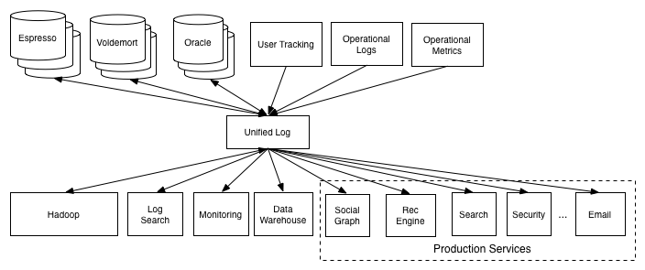
The Origin of Data Streaming
But rather than build a custom solution for every point-to-point integration, they envisioned a more generic solution known as Kafka.
Notes:
They built a system, Kafka that had the following characteristics / capabilities;
a write-once, read-many times.
in-order processing
horizontally scalable
Rather than integrate each data source, shown on the top with the systems shown on the bottom. Kafka allow them to publish the data to central log.
Downstream systems could then consume from this unified log to get the data they needed

Slide 8
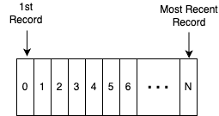
The Log
The key to Kafka’s flexibility is its use of the log data structure.
A time-ordered, append-only sequence of data.
The records are stored in the log as byte arrays, which makes them easily serialized/deserialized into just about anything.
Notes:
The key to Kafka is the log.
The log is simply a time-ordered, append-only sequence of data inserts where the data can be anything (in Kafka, it's just an array of bytes).
If this sounds like the basic data structure upon which a database is built, it is.

Slide 9
Wait a Minute…. Logs Aren’t Revolutionary
Logs have been used inside databases since 1981.
A database uses a log to write out information about the records they will modify before applying the changes, aka changelog.
The log records what happened, and each table or index is a projection of this history into a database table or index.
Since the log is immediately persisted it can be used as the authoritative source in restoring all other persistent structures in the event of a crash.
Notes:
You might be thinking, “logs were around way before 2010”, and you would be correct
In fact, logs have been used inside databases since 1981.
Nearly all databases rely upon a log data structure to buffer all pending database changes before applying them to the database tables.
This changelog, ensures proper ordering of the changes, and represents the authoritative truth of what happened.
The state of each table inside the database, represents the result of these events being performed in the order that they occurred.
Once these events have been applied to the tables, they are purged from the changelog, to make room for newer events.

Slide 10
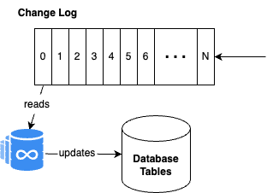
Database Logs: A Single, Fast Consumer
Records are read from the changelog and applied to the table using ACID semantics to guarantee consistency.
Once these changes have been applied, the record is deleted from the log.
Consequently, logs inside a database are intended to retain the records for only a short period.
Notes:
The changelog inside a database has a single consumer that processes the events sequentially
The database reads the event, updates the tables, commits the changes, and deletes the event.
This pipeline is meant to be very efficient, and having a singe consumer guarantees correctness.

Slide 11
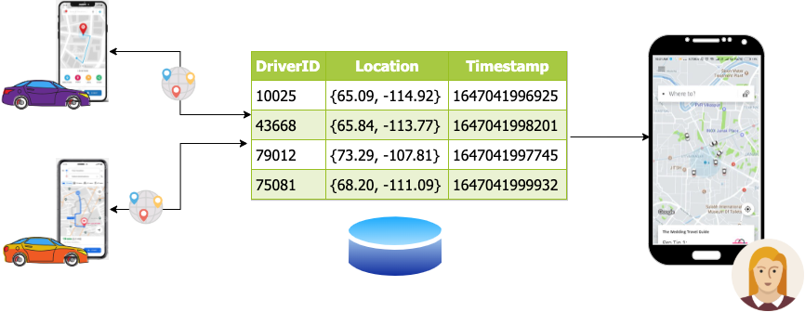
Databases: State-Based Data Model
Notes:
Record the position/state at any point in time using a database and synchronous calls.
Supports full CRUD semantics. Reads/Writes on the same data source.

Slide 12
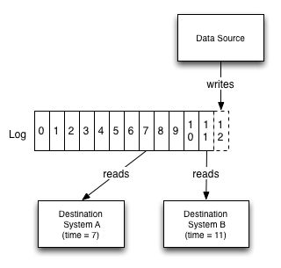
Streaming Logs: Multiple Consumers
Unlike database logs, streaming logs have multiple consumers that consume at different rates.
To accommodate for lagging consumers, streaming platforms were designed to retain data inside their logs for longer periods of time.
Retention periods of days, weeks, or even longer are common.
Streaming platforms acted as a buffer for data ingestion.
Notes:
The logs inside a data streaming platform are quite different:
First off, they are designed to have multiple consumers. Each of these consumers can process the events at a different pace, or even be offline for long periods of time.
Thus, the logs in a data streaming platform are designed to retain the data for longer periods of time than a database change log.
Data can be retained inside a data streaming platform for days, weeks, or longer.
This fact, lead to the desire to build tools that can process these logs to perform analytics, etc.

Slide 13
Stream Processing is Born
These longer retention periods led to the desire to process and analyze the data inside these streaming platform logs, a.k.a. Stream Processing.
Stream processing allows users to perform queries that traditional, state-based databases cannot address;
Point-in-time queries such as, “What was the inventory level for this SKU at 8:50 a.m.?”
Window analysis such as, “What is the average sensor reading over the five-minute period from 10:41 a.m. to 10:46 a.m.?”
Notes:
Rather than querying a database which represents the current state of the data after all events have been applied, these tools allowed you to perform queries over a subset of these events
One common example is performing the same calculation over consecutive “windows” of data, e.g., average number of web page visits over a 5-minute period from 9:00-9:05 am, etc.
These types of queries weren’t possible before the advent of data streaming platforms.
Consequently, a lot of data streaming platforms are used as event-based databases in addition to their data integration duties.

Slide 14
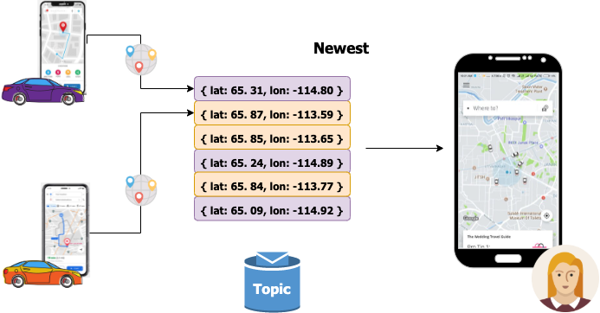
Streaming: Event-Based Data Model
Notes:
Records all events in an immutable sequence.
Each event represents a transition from one state to another.
Current state is the culmination of all the events up to the given point in time.

Slide 15
Stream Processing
Architecture

Slide 16
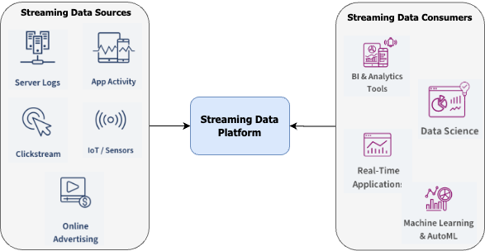
The Emergence of the Streaming Data Platform
A new type of data platform is needed to process data-in-motion and unbounded data streams in real-time.
An analog to the data-at-rest platforms of the past.
Variations include the streaming data lakehouse.

Slide 17
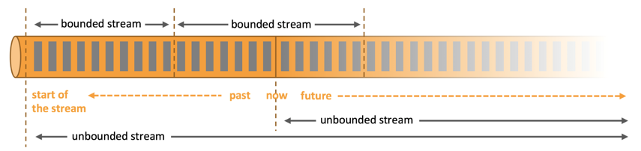
Everything is a Stream
Stream: Sequence of data that is made available over time
All computation processes chunks of data over time, producing results over time → Stream processing.

Slide 18
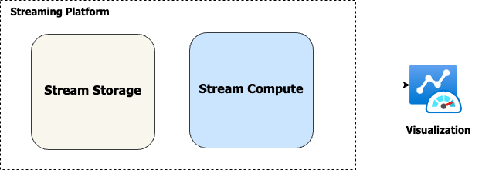
Streaming Data Platform Architecture

Slide 19
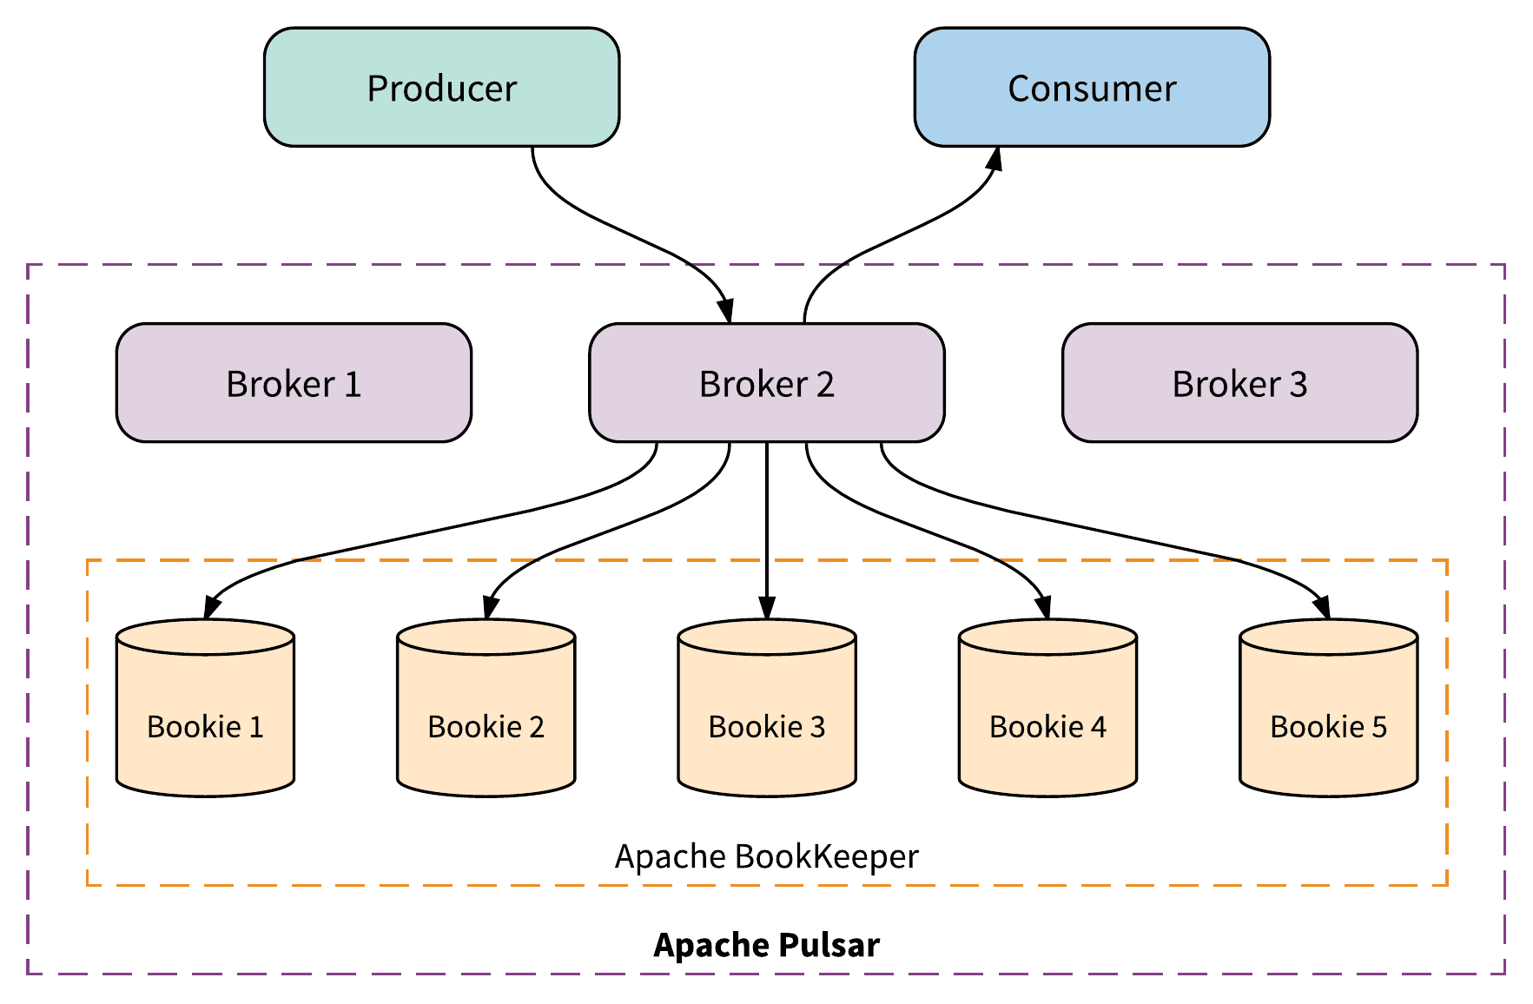
Infinite Stream Storage – Apache Pulsar
Apache Pulsar has a two-tiered architecture with separate Compute and Storage layers.
Brokers – A stateless serving layer that receive and deliver messages to clients.
Bookies – A stateful persistent layer that retains the messages to disk

Slide 20
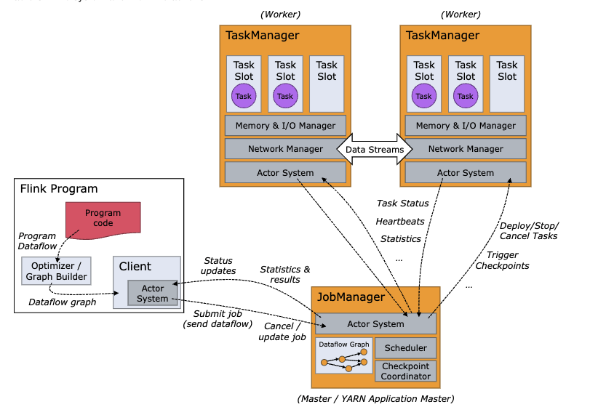
Infinite Stream Compute – Apache Flink
Distributed computing engine.
Stateful processing
Massive scalability

Slide 21
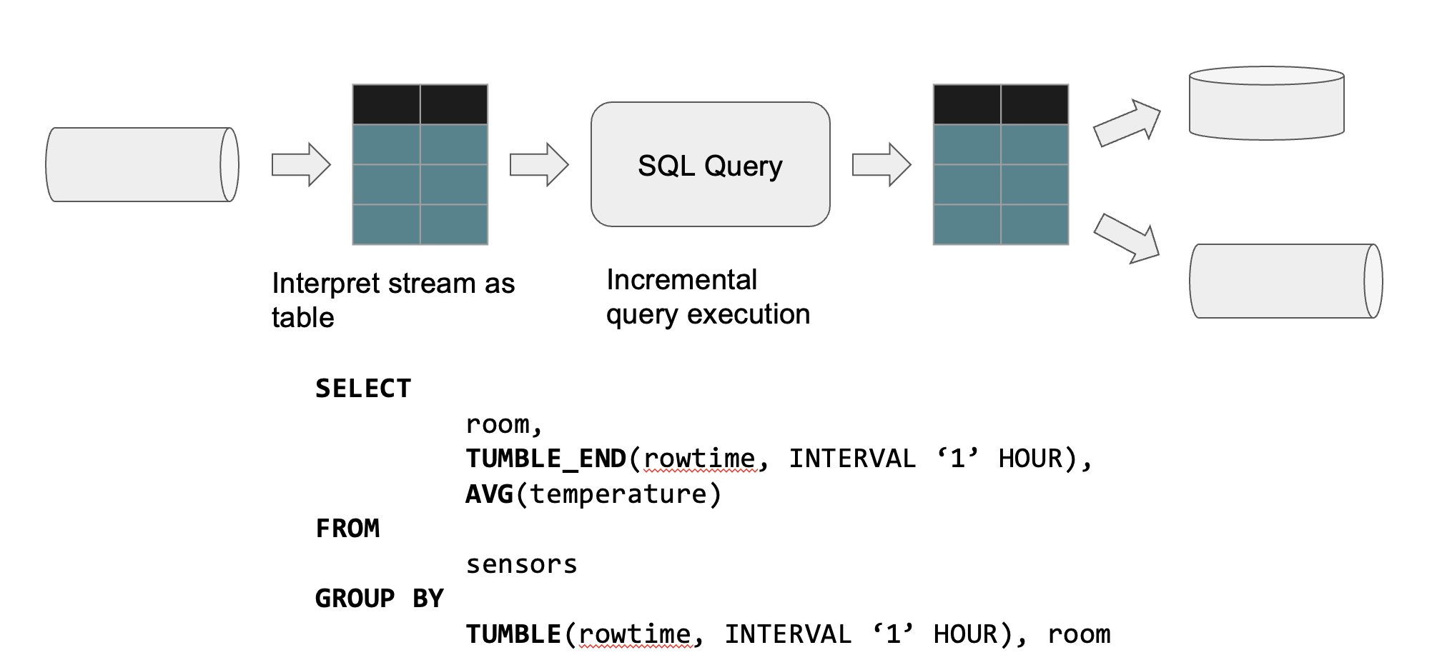
Flink SQL
Notes:
Benefits:
Unlimited Capacity
Automated Scale

Slide 22



Streaming Analytics – Elastic + Kibana
Streaming Data Processing
Data Storage and Indexing
Data Visualization

Slide 23
eCommerce
Use Case

Slide 24
Click Stream Analytics
This data contains the user behavior on the day of November 27, 2017 (behaviors include “click,” “like,” “purchase,” and “add to shopping cart” events).
Each row represents a user behavior event, with the user ID, product ID, product category ID, event type, and timestamp in JSON format.
Calculate the number of “buy” behaviors completed each hour.
Calculate the cumulative number of unique visitors.
Calculate the category rankings to inform us of the most popular categories on our e-commerce site.

Slide 25
Demo

Slide 26
Q&A

Slide 27




Let’s Keep
in Touch!
David Kjerrumgaard
Developer Advocate
@davidkjerrumga1
https://www.linkedin.com/in/davidkj/
https://github.com/davidkj

